Slide 1
What’s new in System.Text.Json

Slide 2
System.Text.Json
High performance JSON library.
Focus on security and compliance.
First shipped with .NET Core 3.
NuGet package targeting netstandard2.0.

Slide 3
System.Text.Json 6
Source Generator.
Mutable JSON DOM (JsonNode).
IAsyncEnumerable support.

Slide 4
System.Text.Json 7
Contract Customization.
Type Hierarchies (polymorphism).
required member support.

Slide 5

What’s new in System.Text.Json 8

Slide 6
Source Generator

Slide 7
Source Generator Themes
Native AOT improvements.
Functional improvements, size reduction.
ASP.NET Core interop improvements.
Easier to register source generators, size reduction.
Bugfixes and reliability improvements.
Closing the functional gap with reflection.

Slide 8
Functional Improvements
required and init member support.
Polymorphism and unspeakable type support.
String enum support for Native AOT.

Slide 9
Demo
ASP.NET on Native AOT

Slide 10
Size Reduction
Internal changes reducing trimmed app size.
Minimal NAOT console app using STJ:
3.4 MB → 2.6 MB (.NET 7 to .NET 8)
23% size reduction.
Demo ASP.NET Core app:
21 MB → 8.9M (.NET 7 to .NET 8)
57% size reduction.
Source https://devblogs.microsoft.com/dotnet/system-text-json-in-dotnet-8/#size-reduction

Slide 11
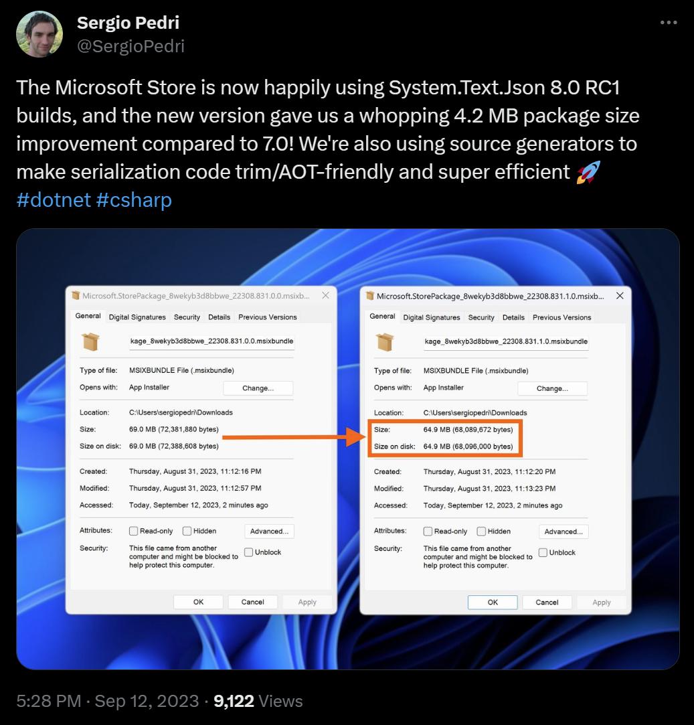
Size Reduction
Source https://twitter.com/SergioPedri/status/1701633787845546426

Slide 12
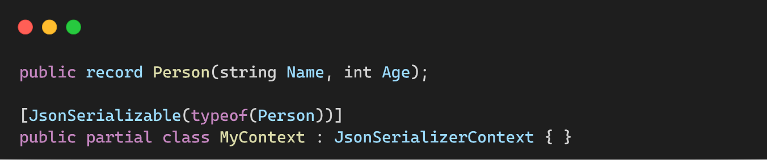
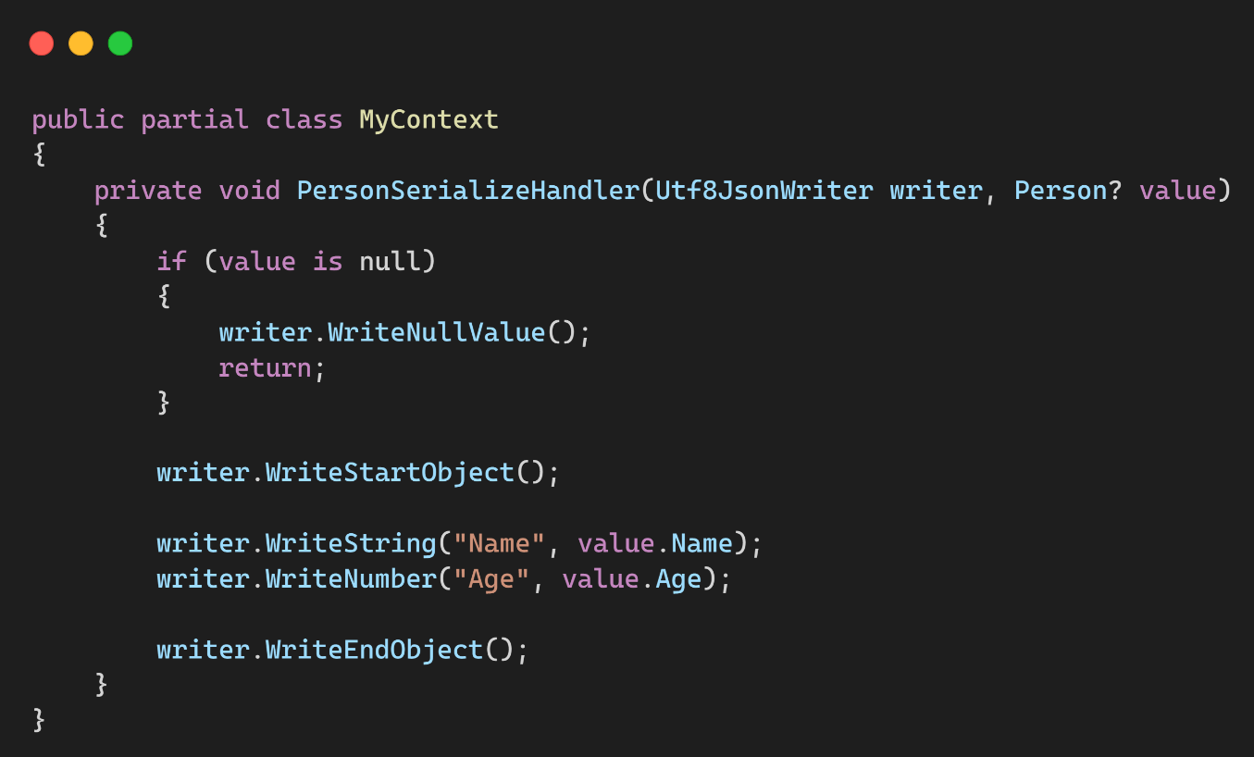
Fast-Path Serialization

Slide 13
Performance
Method | Runtime | Mean | Ratio | Allocated | Alloc Ratio
SerializeAsync | .NET 7.0 | 654.2 ns | 1.00 | 488 B | 1.00
SerializeAsync | .NET 8.0 | 259.6 ns | 0.40 | 32 B | 0.07
Source https://devblogs.microsoft.com/dotnet/performance-improvements-in-net-8/#json

Slide 14
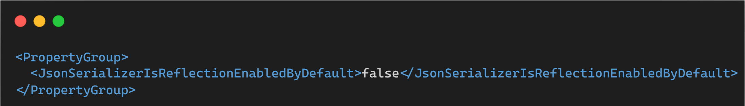
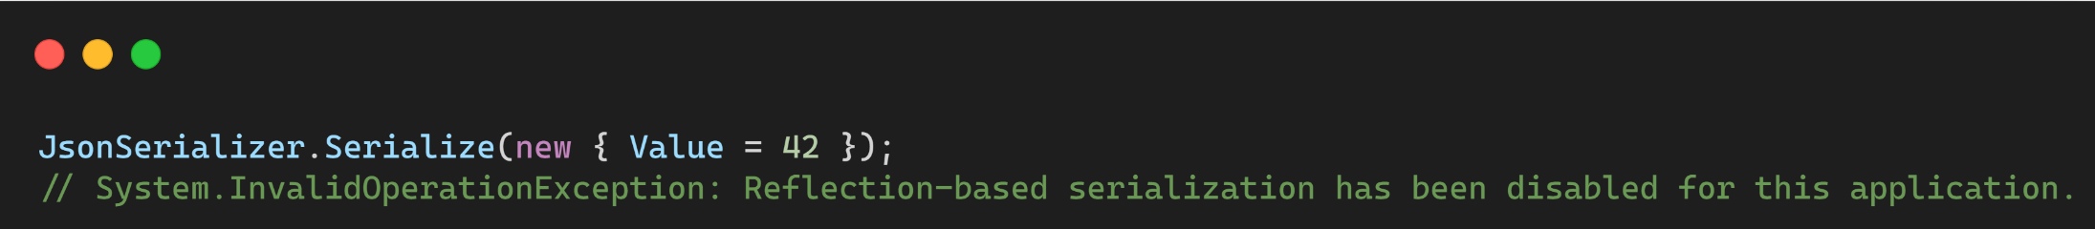
Reflection feature switch

Slide 15
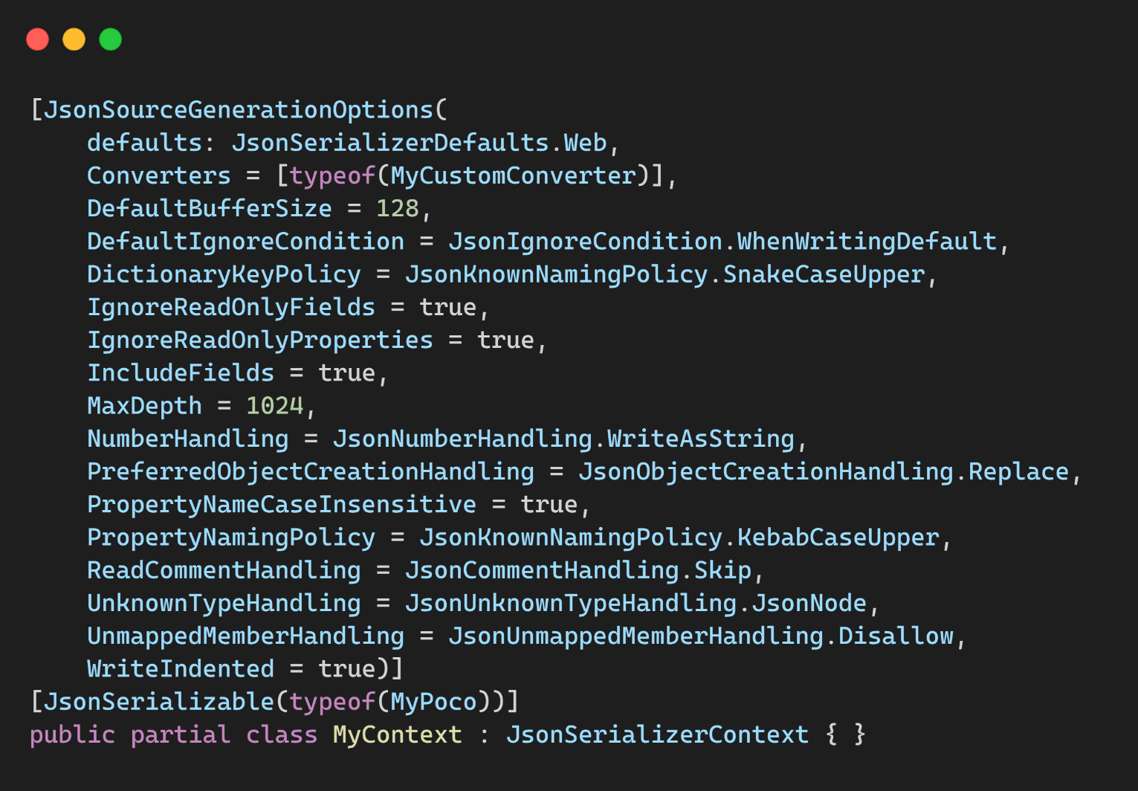
JsonSourceGenerationOptions

Slide 16
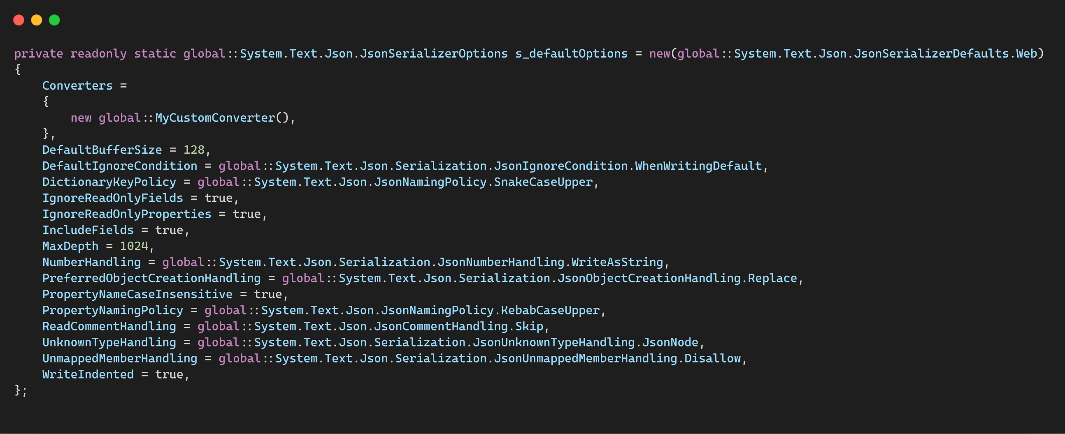
JsonSourceGenerationOptions

Slide 17
Bugfixes
dotnet/runtime#86121 adds incremental caching support to the generator.
dotnet/runtime#86526 and dotnet/runtime#87557 improve formatting of generated code.
dotnet/runtime#87980 adds several new diagnostic warnings.
dotnet/runtime#87136 fixes several bugs related to accessibility modifier resolution.
dotnet/runtime#87383 avoid referencing ignored or inaccessible members.
dotnet/runtime#87484 fixes issues related to JsonNumberHandling support.
dotnet/runtime#87632 fixes support for recursive collection types.
dotnet/runtime#84208 fixes custom converter support for nullable structs.
dotnet/runtime#87796 fixes several bugs in the compile-time attribute parser.
dotnet/runtime#87829 adds support for nesting JsonSerializerContext in containing types.

Slide 18
Serializer Features

Slide 19
Demo
Populate read-only members & Unmapped member handling

Slide 20
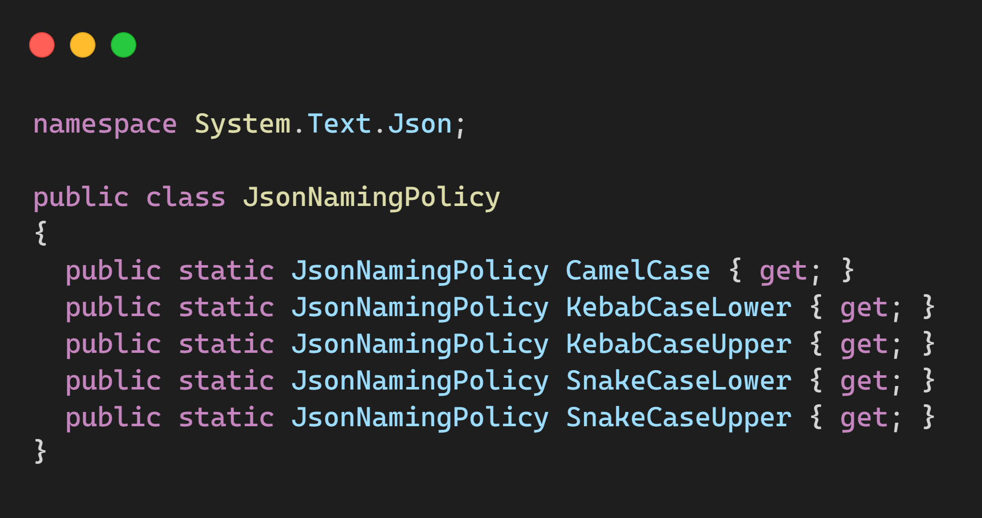
Naming policies

Slide 21
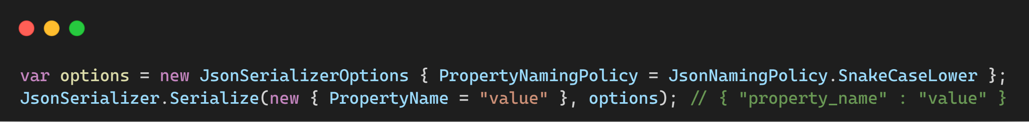
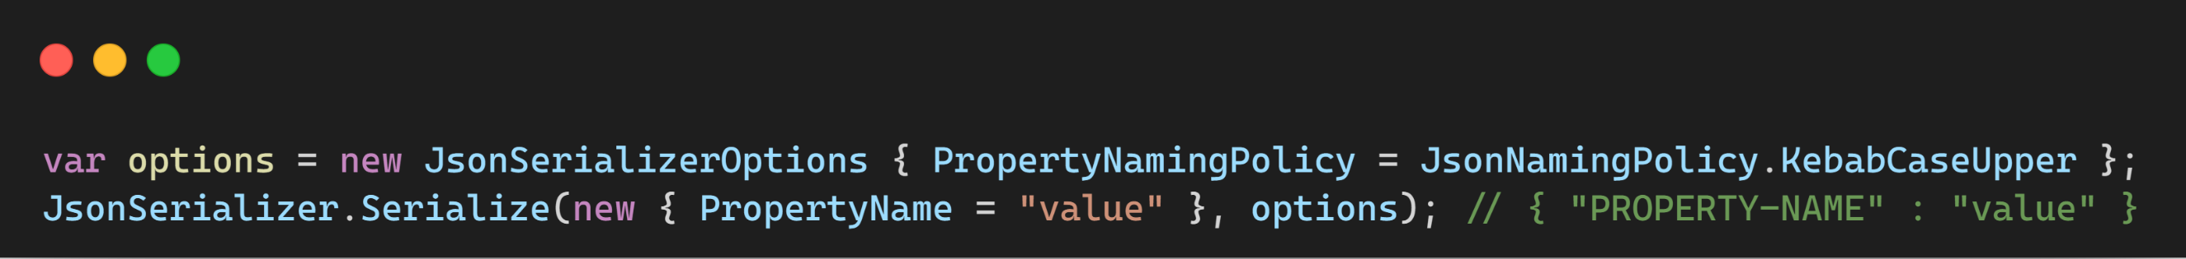
Naming policies

Slide 22
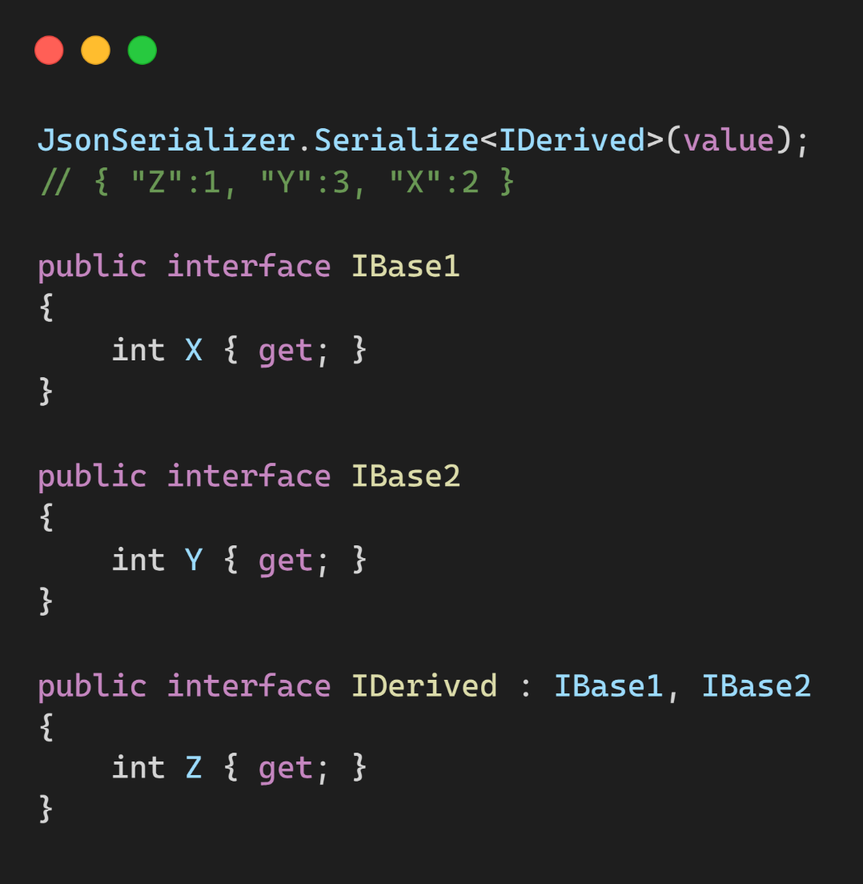
Interface Hierarchies

Slide 23
Out-of-the-Box support
Memory<T> and ReadOnlyMemory<T>
Half, Int128 and UInt128.

Slide 24
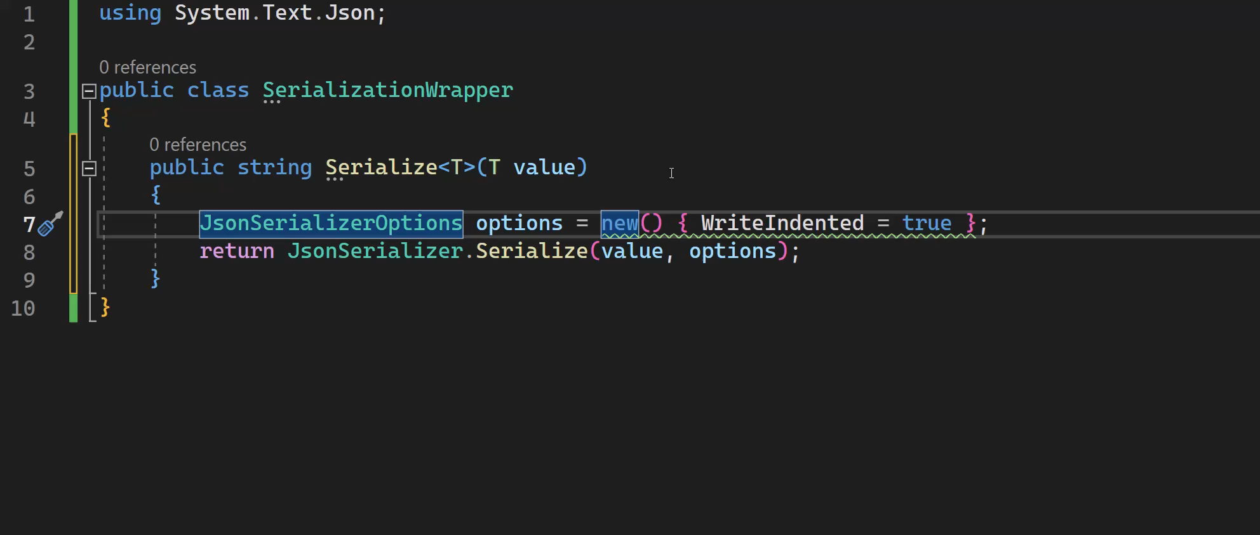
JsonSerializerOptions analyzer

Slide 25
Misc Features
Relax JsonInclude & JsonConstructor attributes.
JsonNode DeepEquals & DeepClone methods.
JsonSerializerOptions.MakeReadOnly() method.
IAsyncEnumerable extensions in System.Net.Http.Json.

Slide 26
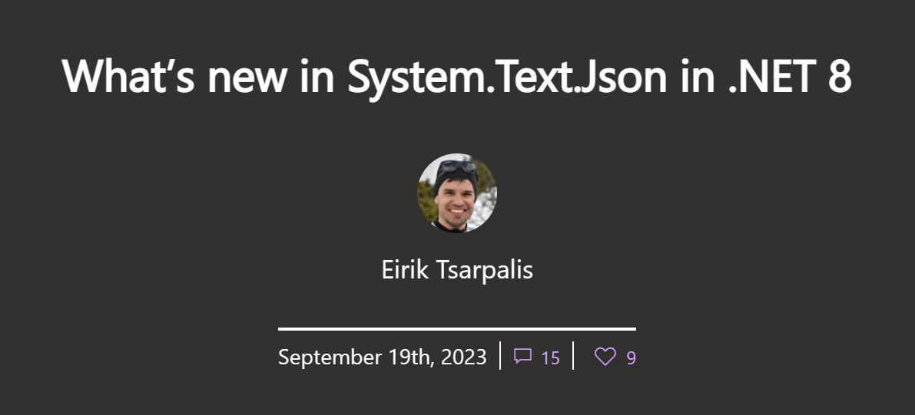
Additional Info
Source https://devblogs.microsoft.com/dotnet/system-text-json-in-dotnet-8

Slide 27
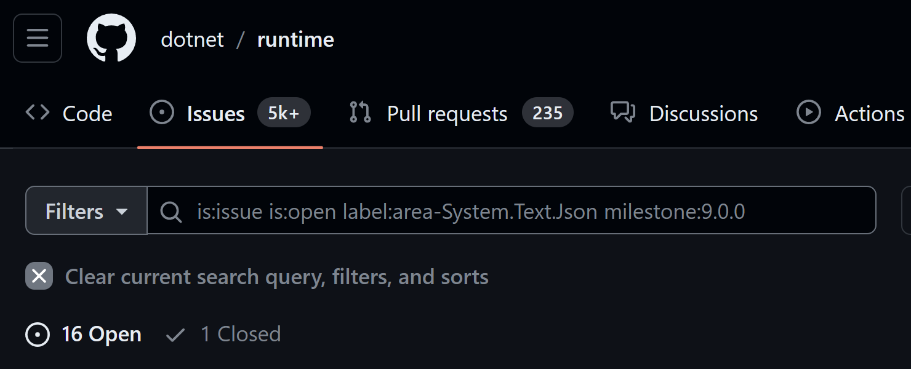
.NET 9 planning is under way

Slide 28

Additional Resources
Docs Overview aka.ms/system-text-json
What’s new in STJ 8 aka.ms/system-text-json-v8
API Documentation aka.ms/system-text-json-apis
Open Issues aka.ms/system-text-json-issues

Slide 29

Thanks for joining!

